Slide 1
Northwind Group
Sales Insights
April 29, 2024
Emily Bowers, Greg Smith, Sergio Villa

Slide 2
Country Order Insights
Top 3 Ordering Countries:
Germany, USA (tied)
Brazil
France
These Countries also have the most customers
USA (n=13)
Germany (n=11)
France (n=11)
Brazil )(n=9)
Recommendation:
Focus more resources on these countries with a higher customer base, which may lead to increased sales.

Slide 3
Companies with Highest Spend
Quick-Stop $117,483
Save-a-lot Market $115,673
Ernst Handel $113,236
Hungry Owl All-Night Grocers $57,317
Rattlesnake Canyon Grocery $52,245
Recommendation: Nurture business relationships with these companies to help drive opportunities for growth.

Slide 4
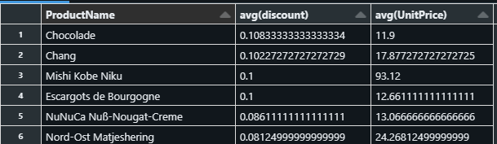
Does avg unit price trend with avg discount?
We can see that the highest discounts tend to coincide with lower Unit Price.
That is except for one product.
More time can let us visualize and potentially sift through the data to see overarching trends. But this shows promise to the idea there is correlation.

Slide 5
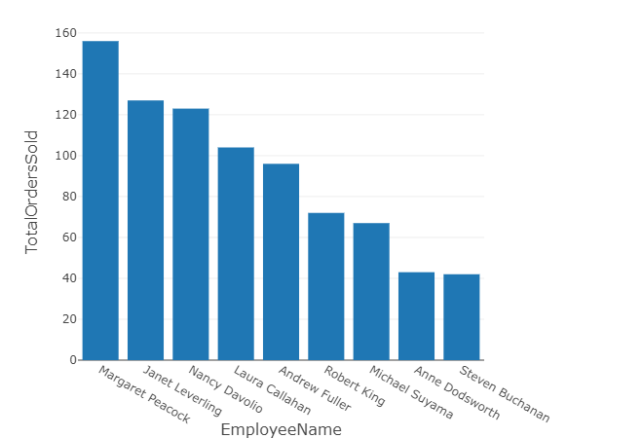
Employees Help Drive Sales
Recommendation:
Recognizing employees who have sold the most orders can highlight top performers and potentially serve as a basis for incentives and/or performance evaluations.

